Slide 1
Software Testing and Quality Assurance Theory and Practice Chapter 4 Control Flow Testing
Notes:
------------------------------------------------------------------
------------------------------------------------------------------
-------------------------------------------------------------------
--------------------------------------------------------------------

Slide 2
Outline of the Chapter
Basic Idea
Outline of Control Flow Testing
Control Flow Graph
Paths in a Control Flow Graph
Path Selection Criteria
Generating Test Input
Containing Infeasible Paths
Summary

Slide 3
Basic Idea
Two kinds of basic program statements:
Assignment statements (Ex. x = 2*y; )
Conditional statements (Ex. if(), for(), while(), …)
Control flow
Successive execution of program statements is viewed as flow of control.
Conditional statements alter the default flow.
Program path
A program path is a sequence of statements from entry to exit.
There can be a large number of paths in a program.
There is an (input, expected output) pair for each path.
Executing a path requires invoking the program unit with the right test input.
Paths are chosen by using the concepts of path selection criteria.
Tools: Automatically generate test inputs from program paths.

Slide 4
Outline of Control Flow Testing
Figure 4.1: The process of generating test input data for control flow testing.

Slide 5
Outline of Control Flow Testing
Inputs to the test generation process
Source code
Path selection criteria: statement, branch, …
Generation of control flow graph (CFG)
A CFG is a graphical representation of a program unit.
Compilers are modified to produce CFGs. (You can draw one by hand.)
Selection of paths
Enough entry/exit paths are selected to satisfy path selection criteria.
Generation of test input data
Two kinds of paths
Executable path: There exists input so that the path is executed.
Infeasible path: There is no input to execute the path.
Solve the path conditions to produce test input for each path.
Notes:
def process_transaction(user_balance, transaction_amount):
if user_balance > 0:
if transaction_amount > user_balance:
return "Insufficient Funds"
else:
# This is the logically flawed part of the code
if transaction_amount > 0:
return "Transaction Processed"
else:
return "Account Inactive"

Slide 6
Control Flow Graph
Symbols in a CFG
Figure 4.2: Symbols in a control flow graph

Slide 7
Control Flow Graph
Figure 4.4: A high-level CFG representation of openfiles().

Slide 8
Control Flow Graph
Example code: ReturnAverage()
public static double ReturnAverage(int value[], int AS, int MIN, int MAX){
/* Function: ReturnAverage Computes the average of all those numbers in the input array in
the positive range [MIN, MAX]. The maximum size of the array is AS. But, the array size
could be smaller than AS in which case the end of input is represented by -999. */
int i, ti, tv, sum;
double av;
i = 0; ti = 0; tv = 0; sum = 0;
while (ti < AS && value[i] != -999) {
ti++;
if (value[i] >= MIN && value[i] <= MAX) {
tv++;
sum = sum + value[i];
}
i++;
}
if (tv > 0)
av = (double)sum/tv;
else
av = (double) -999;
return (av);
}
Figure 4.6: A function to compute the average of selected integers in an array.

Slide 9
Control Flow Graph
Figure 4.7: A CFG representation of ReturnAverage().

Slide 10
Path Selection Criteria
Statement coverage criterion
Statement coverage means executing individual program statements and observing the output.
100% statement coverage means all the statements have been executed at least once.
Cover all assignment statements.
Cover all conditional statements.
Less than 100% statement coverage is unacceptable.
Table 4.4: Paths for statement coverage of the CFG of Figure 4.7.
SCPath1 | 1-2-3(F)-10(F)-11-13
SCPath2 | 1-2-3(T)-4(T)-5-6(T)-7(T)-8-9-3(F)-10(T)-12-13

Slide 11
Path Selection Criteria
Branch coverage criterion
A branch is an outgoing edge from a node in a CFG.
A condition node has two outgoing branches – corresponding to the True and False values of the condition.
Covering a branch means executing a path that contains the branch.
100% branch coverage means selecting a set of paths such that each branch is included on some path.

Slide 12
Path Selection Criteria
Figure 4.8: The dotted arrows represent the branches not covered
by the statement covering in Table 4.4.

Slide 13
Path Selection Criteria
Branch coverage criterion
A branch is an outgoing branch (edge) from a node in a CFG.
A condition node has two outgoing branches – corresponding to the True and False values of the condition.
Covering a branch means executing a path that contains the branch.
100% branch coverage means selecting a set of paths such that each branch is included on some path.
Table 4.5: Paths for branch coverage of the flow graph of Figure 4.7.
BCPath 1 | 1-2-3(F)-10(F)-11-13
BCPath 2 | 1-2-3(T)-4(T)-5-6(T)-7(T)-8-9-3(F)-10(T)-12-13
BCPath 3 | 1-2-3(T)-4(F)-10(F)-11-13
BCPath 4 | 1-2-3(T)-4(T)-5-6(F)-9-3(F)-10(F)-11-13
BCPath 5 | 1-2-3(T)-4(T)-5-6(T)-7(F)-9-3(F)-10(F)-11-13

Slide 14
Path Selection Criteria
Predicate coverage criterion
If all possible combinations of truth values of the conditions affecting a path have been explored under some tests, then we say that predicate coverage has been achieved.

Slide 15
Path Selection Criteria
Figure 4.9: Partial control flow graph with (a) OR operation and (b) AND operation.

Slide 16
Generating Test Input
Having identified a path, a key question is how to make the path execute, if possible.
Generate input data that satisfy all the conditions on the path.
Key concepts in generating test input data
Input vector
Predicate
Path condition
Predicate interpretation
Path predicate expression
Generating test input from path predicate expression

Slide 17
Generating Test Input
Input vector
An input vector is a collection of all data entities read by the routine whose values must be fixed prior to entering the routine.
Members of an input vector can be as follows.
Input arguments to the routine
Global variables and constants
Files
Contents of registers (in Assembly language programming)
Network connections
Timers
Example: An input vector for openfiles() consists of individual presence or absence of the files “files1,” “file2,” and “file3.”
Example: The input vector of ReturnAverega() shown in Figure 4.6 is <value[], AS, MIN, MAX>.

Slide 18
Generating Test Input
Predicate
A predicate is a logical function evaluated at a decision point.
Example: ti < AS is a predicate in node 3 of Figure 4.7.
Example: The construct OB is a predicate in node 5 in Figure 4.9.
Path predicate
A path predicate is the set of predicates associated with a path.
Figure 4.10: An example path from Fig. 4.7:
1-2-3(T)-4(T)-5-6(T)-7(T)-8-9-3(F)-10(T)-12-13.
Figure 4.11: The path predicate for the path shown in Figure 4.10.
ti < AS ≡ True
value[i] != -999 ≡ True
value[i] >= MIN ≡ True
value[i] <= MAX ≡ True
ti < AS ≡ False
tv > 0 ≡ True

Slide 19
Generating Test Input
Predicate interpretation
A path predicate may contain local variables.
Example: <i, ti, tv> in Figure 4.11 are local variables.
Local variables play no role in selecting inputs that force a path to execute.
Local variables can be eliminated by a process called symbolic execution.
Predicate interpretation is defined as the process of
symbolically substituting operations along a path in order to express the predicate solely in terms of the input vector and a constant vector.
A predicate may have different interpretations depending on how control reaches the predicate.

Slide 20
Generating Test Input
Path predicate expression
An interpreted path predicate is called a path predicate expression.
A path predicate expression has the following attributes.
It is void of local variables.
It is a set of constraints in terms of the input vector, and, maybe, constants.
Path forcing inputs can be generated by solving the constraints.
If a path predicate expression has no solution, the path is infeasible.
Figure 4.13: Path predicate expression for the path shown in Figure 4.10.
0 < AS ≡ True …… (1)
value[0] != -999 ≡ True …… (2)
value[0] >= MIN ≡ True …… (3)
value[0] <= MAX ≡ True …… (4)
1 < AS ≡ False …… (5)
1 > 0 ≡ True …… (6)

Slide 21
Generating Test Input
Path predicate expression
An example of infeasible path
Figure 4.14: Another example of path from Figure 4.7.
1-2-3(T)-4(F)-10(T)-12-13
Figure 4.15: Path predicate expression for the path shown in Figure 4.14.
0 < AS ≡ True …… (1)
value[0] != -999 ≡ True …… (2)
0 > 0 ≡ True …… (3)

Slide 22
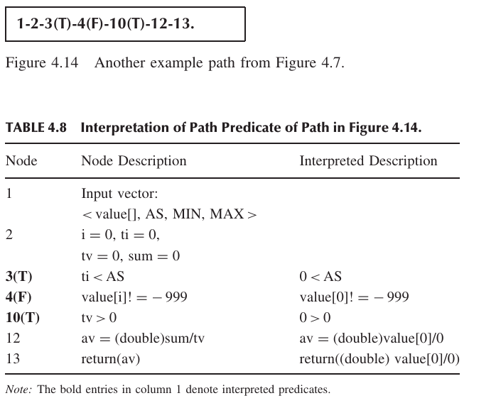
Generating Test Input
Path predicate expression (An example of infeasible path)

Slide 23
Generating Test Input
Generating input data from a path predicate expression
Consider the path predicate expression of Figure 4.13 (reproduced below.)
0 < AS ≡ True …… (1)
value[0] != -999 ≡ True …… (2)
value[0] >= MIN ≡ True …… (3)
value[0] <= MAX ≡ True …… (4)
1 < AS ≡ False …… (5)
1 > 0 ≡ True …… (6)
One can solve the above equations to obtain the following test input data
AS = 1
MIN = 25
MAX = 35
Value[0] = 30
Note: The above set is not unique.

Slide 24
Containing Infeasible Paths
A program unit may contain a large number of paths.
Path selection becomes a problem. Some selected paths may be infeasible.
Apply a path selection strategy:
Select as many short paths as possible.
Choose longer paths.
There are efforts to write code with fewer/no infeasible paths.

Slide 25
Summary
Control flow is a fundamental concept in program execution.
A program path is an instance of execution of a program unit.
Select a set of paths by considering path selection criteria.
Statement coverage
Branch coverage
Predicate coverage
All paths
From source code, derive a CFG (compilers are modified for this.)
Select paths from a CFG based on path selection criteria.
Extract path predicates from each path.
Solve the path predicate expression to generate test input data.
There are two kinds of paths.
feasible
infeasible

